Slide 2
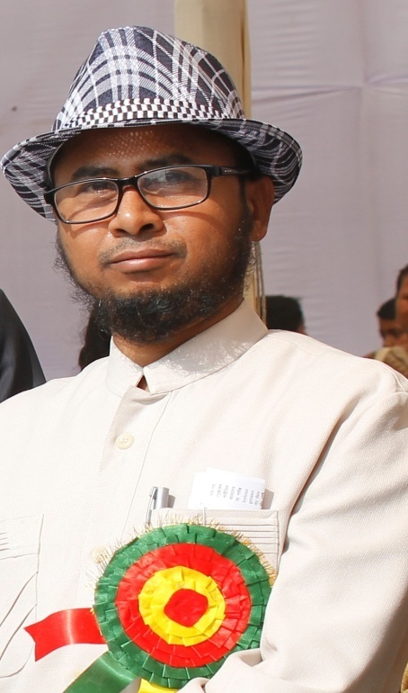
A. Gaffar Mozumder
Senior Teacher (English)
Uttarkhan Govt. Secondary School
Uttara, Dhaka.
01734101510
abdulgaffarmozumder@gmail.com
Gaffar Mozumder

Slide 3
# Class: Six # Sub: English 2nd
# Section: Golap # Time: 40 minutes
# Toatal SS: 60 # Date: 25. 03. 2018

Slide 4
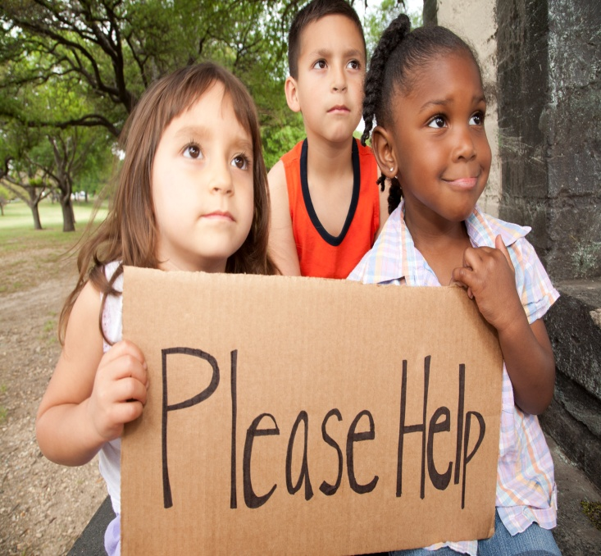
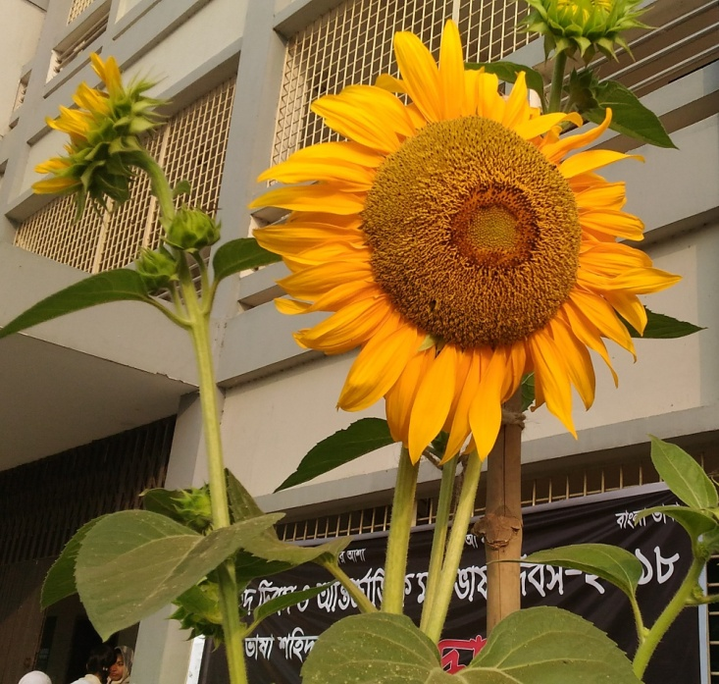
We help others.
Don’t we help others?
The flower looks nice.
Doesn’t the flower look nice?

Slide 5
Today’s topic
Changing Sentences
(Assertive—Interrogative)
Day: 2
Out of 2

Slide 6
Learning Outcomes:
By the end of this lesson
you will be able to
* make interrogative sentences using do/does/did.
* use who/what to make questions.
* change an assertive sentence into interrogative.

Slide 7
Let's discuss
Rules & Examples

Slide 8
Rule: 2
Assertive:
S + V1/Vs/V2.
Interrogative:
Don’t/Doesn’t/Didn’t + S + V1 ?

Slide 9
Examples:
They go to school.
Don’t
They go to school
.
?
Don’t they go to school ?

Slide 10
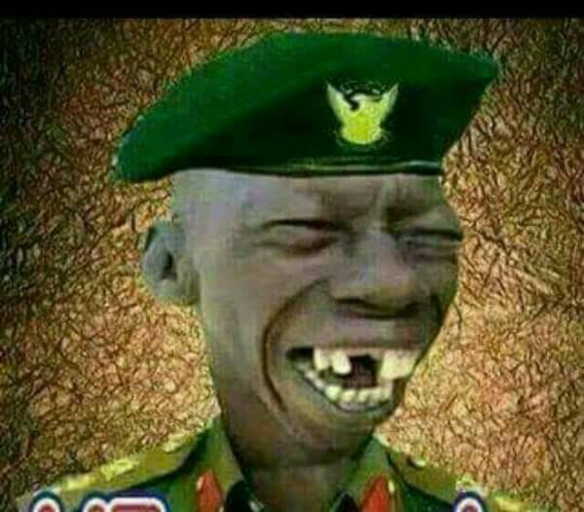
More Examples:
He smiles happily.
Doesn’t
He smiles happily
.
?
Doesn’t he smile happily ?

Slide 11
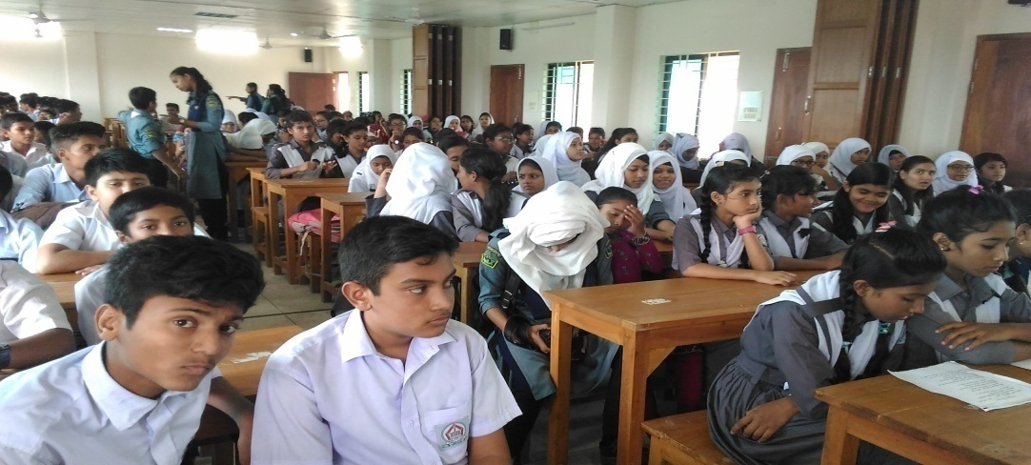
More Examples:
They gathered in the auditorium.
Didn’t
They gathered in the auditorium
.
?
Didn’t they gather in the auditorium ?

Slide 12
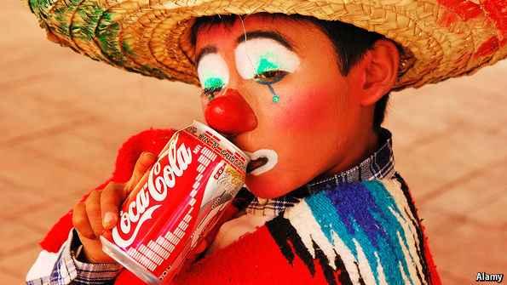
More Examples:
I do not like soft drink.
Do I like soft drink?
An honest man does not tell a lie.
Does an honest man tell a lie?
We did not disturb you.
Did we disturb you?

Slide 13
Rule: 3
Assertive:
Everybody/Everyone + V.
Interrogative:
Who + do not/does not/did not/(Aux)not +V?

Slide 14
Examples:
Everybody wants to be happy.
Who does not want to be happy?
Everyone has done the homework.
Who has not done the homework?

Slide 15
Rule: 4
Assertive:
Nobody/None + V.
Interrogative:
Who +V?

Slide 16
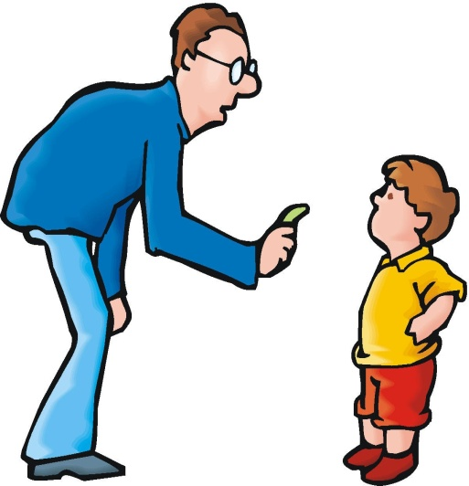
Examples:
Nobody loves a naughty boy.
Who loves a naughty boy ?
None should break discipline.
Who should break discipline ?

Slide 17
Rule: 5
Assertive:
a) Everything + V.
b) Nothing + V.
Interrogative:
a) What + do not/does not/did not/(Aux)not + V?
b) What + V ?

Slide 18
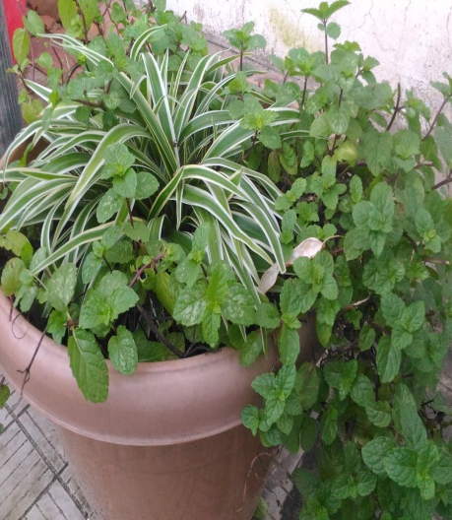
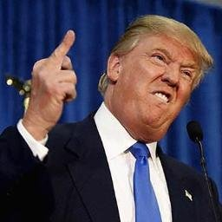
Examples:
Everything is useful.
What is not useful ?
Nothing can make him cool.
What can make him cool ?

Slide 20
Do interrogative:
a) I obey my parents.
b) A good student goes to school regularly.
c) Everybody should drink pure water.

Slide 22
Change the following sentences into Interrogative.
a) The farmers grow crops.
b) Nobody can live alone.
c) A teacher builds an education nation.
d) The freedom fighters fought for the country.
e) Everyone helps the poor.

